Slide 1
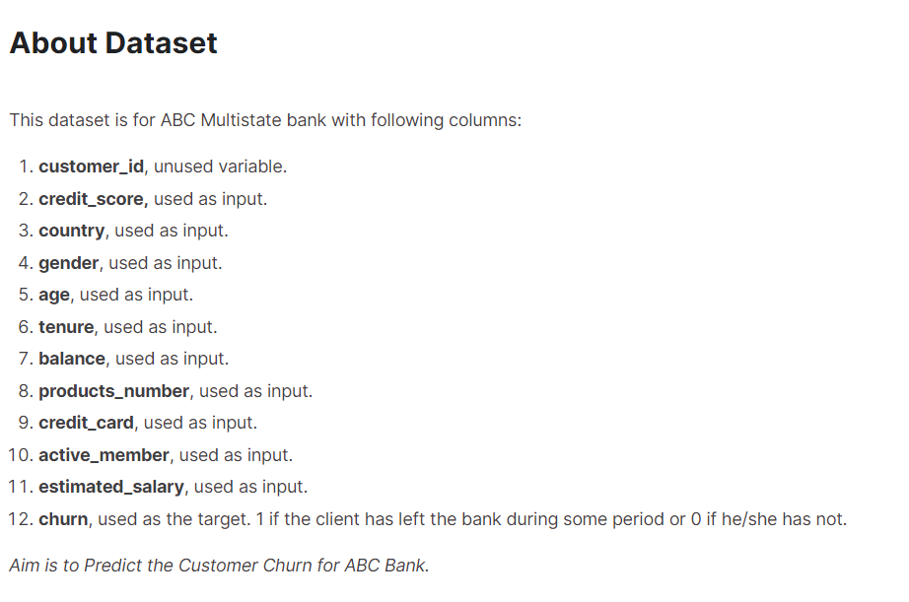
Bank Customer Churn Prediction
Dataset: https://www.kaggle.com/code/kmalit/bank-customer-churn-prediction

Slide 2
Business Objective:
1. Identify the best ML model to predict customer churn
2. Understand the key predictors that contribute to customer churn

Slide 3
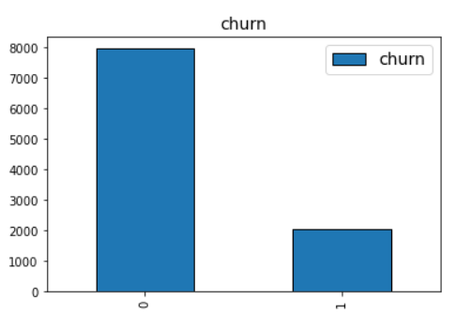

Exploratory Data Analysis
Imbalanced Classes
Accuracy Metric: Recall and Precision
Notes:
視需要多列出 幾點。

Slide 4
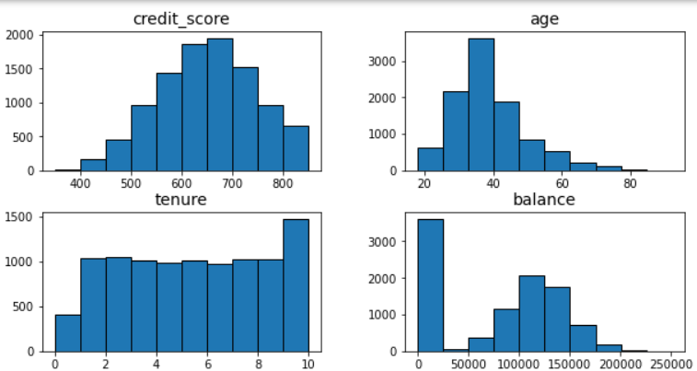
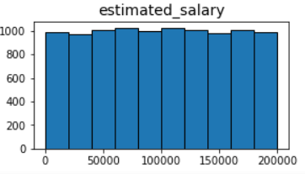
Exploratory Data Analysis
Numeric Features Need Scaling
Notes:
使用項目符號並逐字討論 所有細節。

Slide 5
Data Cleaning and Transformation
Credit Score
Age
Tenure
Balance
Products Number
Simple Imputer (strategy = median)
Standard Scaler
Estimated Salary

Slide 6
Data Cleaning and Transformation
Gender
Credit Card
Active Member
Simple Imputer (strategy = most frequent)
Country
Dummy Variables
Germany as baseline

Slide 7
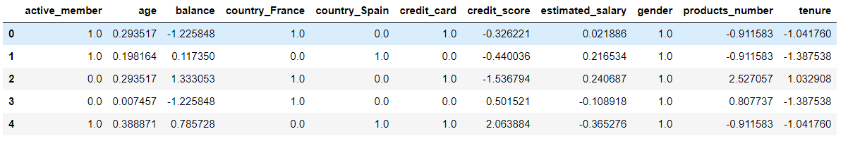
Data Cleaning and Transformation

Slide 8
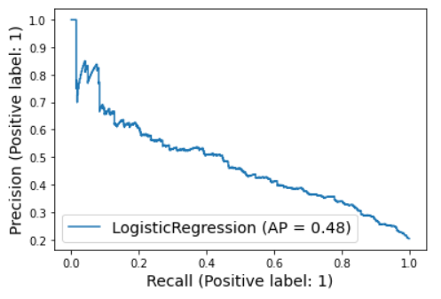
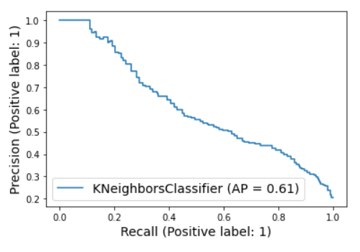
Logistic Regression and KNN
Recall: 0.80
Precision: 0.35
AP: 0.48
Recall: 0.80
Precision: 0.45
AP: 0.61

Slide 9
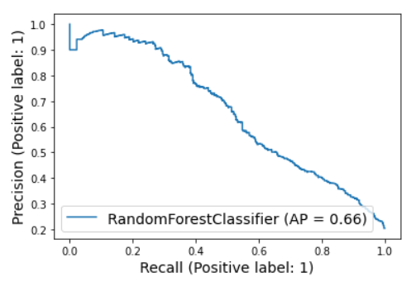
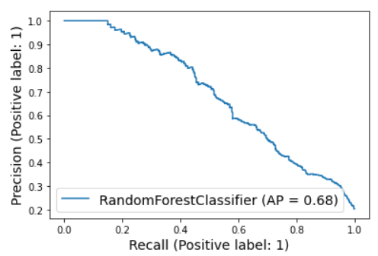
Bagged Tree and Random Forest
Recall: 0.80
Precision: 0.43
AP: 0.66
Recall: 0.80
Precision: 0.40
AP: 0.68

Slide 10
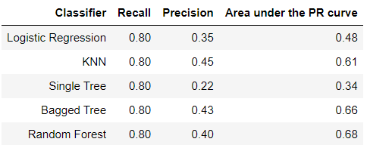



Metrics Table
Summary: KNN and Random forest are the best ML model to predict customer churn

Slide 11
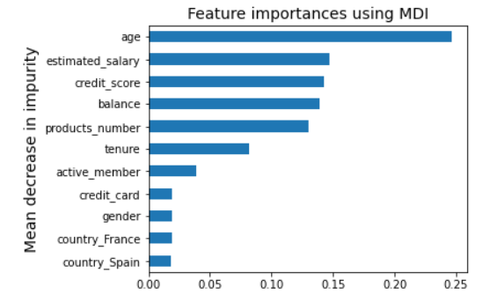

Feature Importance
Summary: Age, estimated salary, credit score, balance and products number are important variables that contribute to customer churn.

